Slide 1
Summer Olympic
By Rohini Darne

Slide 2
Table of Contents
Objective of Project
Data Loading and Description
Data Profiling
Understanding the Dataset
Pre Profiling
Pre-processing
Post Profiling
Questions
Conclusion

Slide 3
Objective of Project
1. Provide the opportunity to implement the learnings of EDA
2. Develop the mindset of Data Scientist
3. Get hands-on the different techniques of EDA
4. Get familiar and deal with technical issues and work on it
Data Loading and Description – Refer Datasheet
Data Profiling – Refer Datasheet
Understanding the Dataset
Pre Profiling
Pre-processing
Post Profiling

Slide 4
Questions
The rate of participation since 1896
The rate of participation of women since 1896
Maximum women participation in which 3 games
Minimum women participation in which 3 games
Maximum no of Gold/Silver/Bronze Medal won by Country
Percentage of Women wins Gold Medal - 26.58%
Percentage of Men won Gold Medal - 73.41%
Women’s have won gold medal count - 2788, Silver - 2801, Bronze - 2830
Year Vs Medals comparison
Men Vs Women participation
Overall Conclusion
Cover in the last slide

Slide 5
Summer Olympic (Background)
The 1896 Summer Olympics officially known as the Games of the I Olympiad, was the first international Olympic Games held in modern history. Organised by the International Olympic Committee (IOC), which had been created by Pierre de Coubertin, it was held in Athens, Greece, from 6 to 15 April 1896.
The 1896 Olympics were regarded as a great success. The Games had the largest international participation of any sporting event to that date. The Panathenaic Stadium overflowed with the largest crowd ever to watch a sporting event.^{[4]} After the Games, Coubertin and the IOC were petitioned by several prominent figures, including Greece's King George and some of the American competitors in Athens, to hold all the following Games in Athens. However, the 1900 Summer Olympicswere already planned for Paris and, except for the Intercalated Games of 1906, the Olympics did not return to Greece until the 2004 Summer Olympics, 108 years later.

Slide 6
Data Source and dataset
Name of dataset – Summer Olympic.csv
Sponsoring Organization: INSAID
Year: 2019
Description: This sample set contains Summer Olympics games details since 1896 till 2005
Is it a sample? If yes, was it properly sampled?
- Yes, it is a sample. We don't have official information about the data collection method, but it appears *not* to be a random sample, so we can assume that it is not representative.

Slide 7
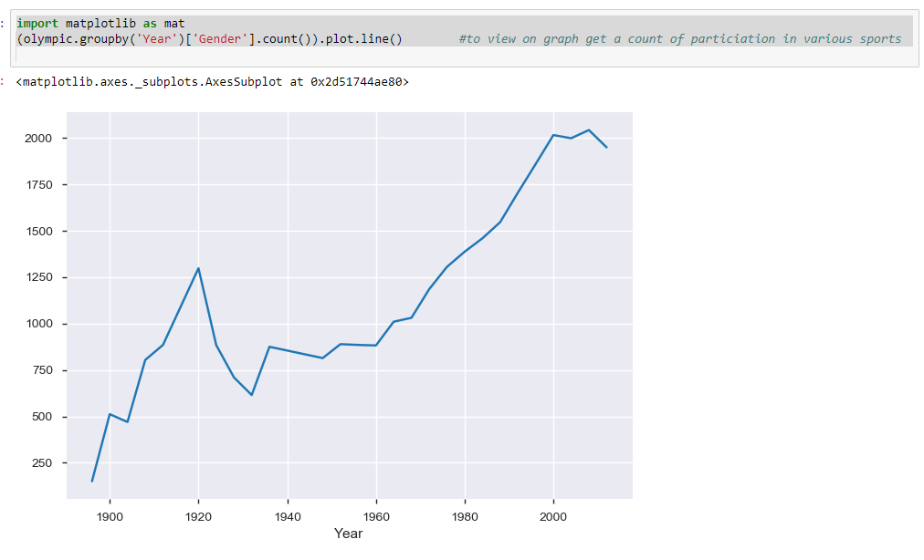
The trend of Men’s & Women participation since 1896
The 1916 Summer Olympics, to be held in Berlin, capital of the German Empire, were cancelled due to World War I. The aftermath of the war and the Paris Peace Conference, 1919 affected the Olympic Games not only due to new states being created, but also by sanctions against the nations that lost the war and were blamed for starting it. Hungary, Germany, Austria, Bulgaria, and the Ottoman Empire were banned from competing in the Games. Germany did not return to Olympic competition until 1928 .
Trend of participation was raised from 1986 – 1920, it is declined from 1920 – 1935
And raised up actually from 1970 onwards

Slide 8
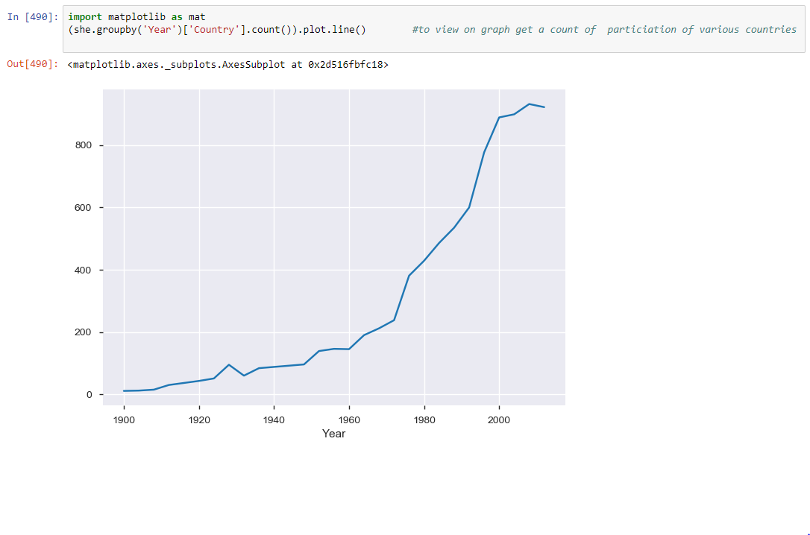
The trend of Women participation since 1896
Trend of Women participation raised from 1975 onwards

Slide 9
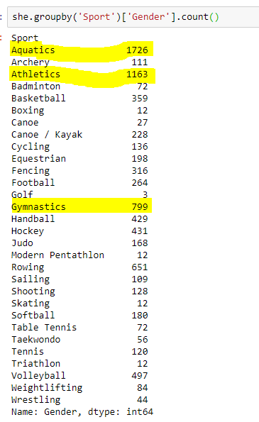
Which 3 games wherein Women participation are more
1. Aquatics - 1726
2. Athletics - 1163
3. Gymnastics - 799

Slide 10
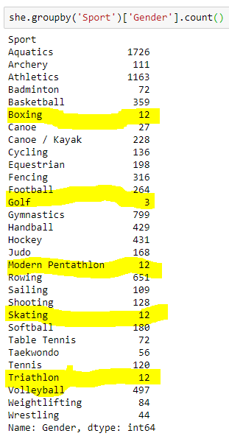
Which 3 games wherein there is very minimum participation
Golf - 3
Boxing – 12
Modern Pentathlon – 12
Skating – 12
Triathlon - 12

Slide 11
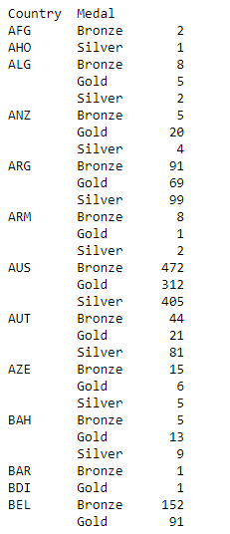
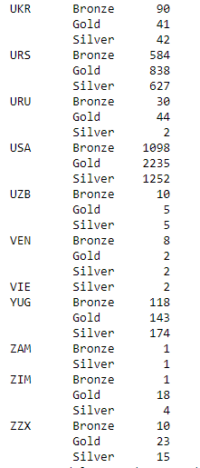
Maximum no of Gold/Silver/Bronze Medal won by Country
Gold – USA (2235)
Silver – USA (1252)
Bronze – USA (1098)
Gold – URS (838)
Silver – URS (627)
Bronze – URS (584)
Gold – AUS (312)
Silver – AUS (405)
Bronze – AUS (472)

Slide 12
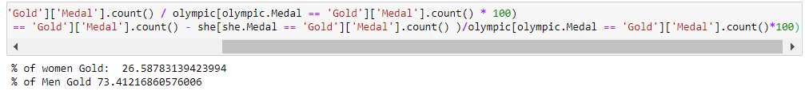
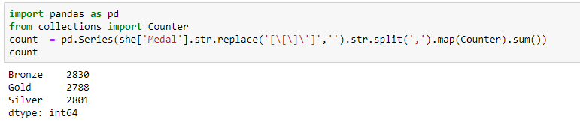
Percentage of Women wins Gold Medal - 26.58%
Percentage of Men won Gold Medal - 73.41%
Women’s have won medal count - 2788, Silver - 2801, Bronze - 2830

Slide 13
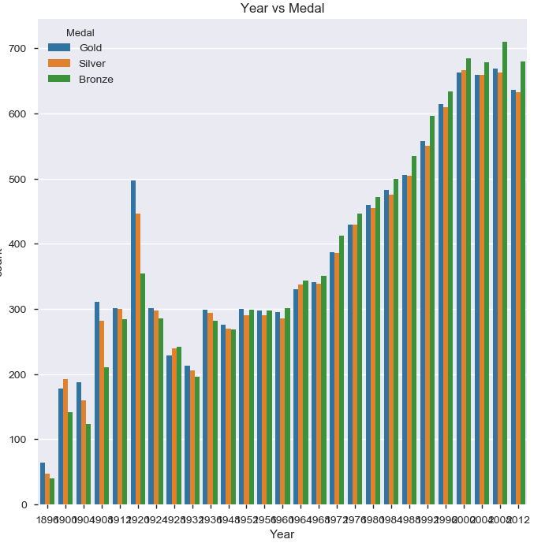
Year Vs Medals comparison

Slide 14
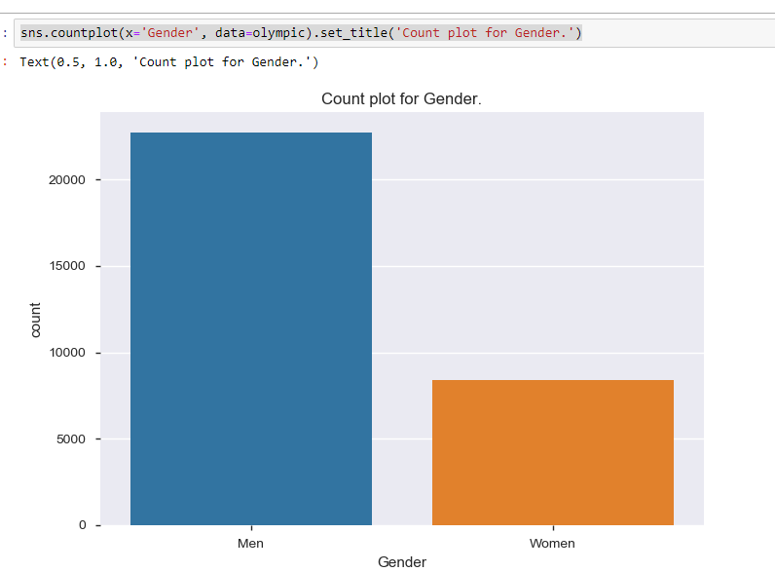
Men Vs Women participation

Slide 15
Overall Conclusion
Summer Olympic is a well know Olympic game started in 1896 in Athens, Greece.
There was decline in the participation in 1920’s due to World War I.
The participation have started rise up from 1970’s
There was no Women participation when this game started in 1896 in Athens city
The Women’s participations have started raise from 1975.
Men’s Participation is more than double compare to Women.
USA has won maximum Gold, Silver and Bronze Medal, 2nd is USR and then Australia.

Slide 16
Thank You

